Slide 1
Creating Diagnosis/Problem Favorites in Genesis (Another 1% Gain!)
Darrell J. Baranko, MD, FACP

Slide 2
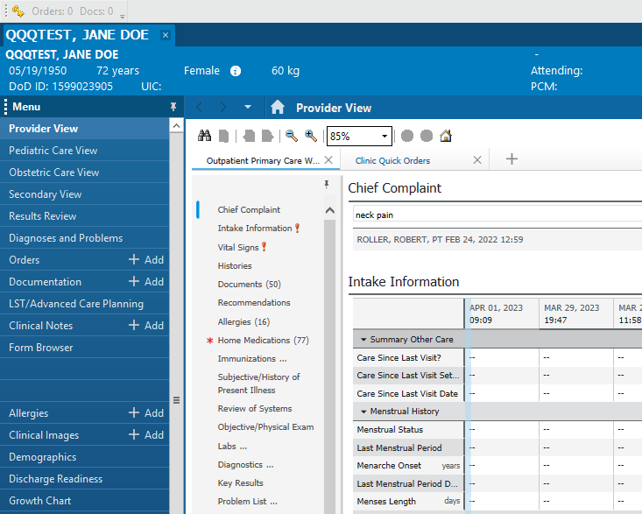

Slide 3
First Steps
Go to the Blue Menu Column and Click “ Diagnoses and Problems”
Then Click “Add” under “Diagnosis”
***I found that it is easier to find a diagnosis under “Diagnosis” compared to “Problems”

Slide 4
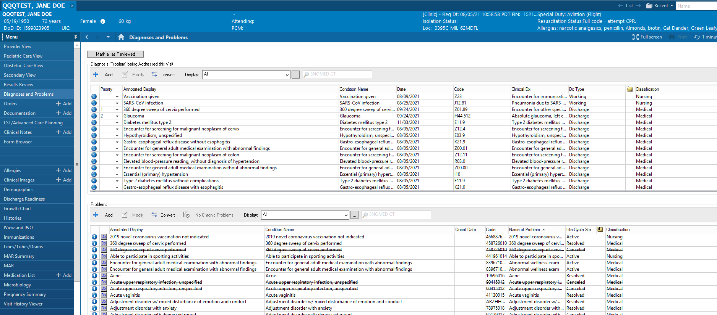

Slide 5
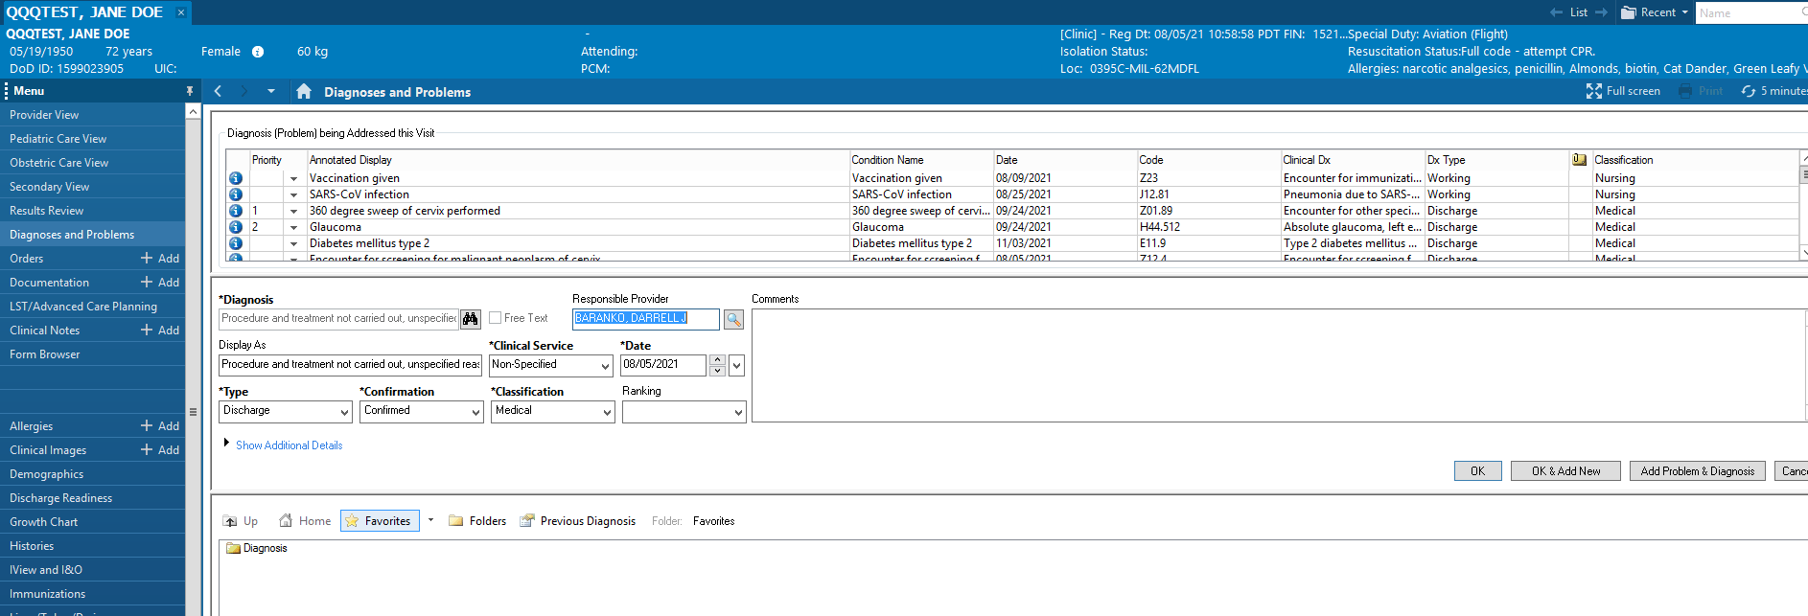

Slide 6
Once you enter your diagnosis, you can select “OK” to add just one diagnosis or “Add Problem and Diagnosis” to have both a problem and a diagnosis.
N.B. The folder for Diagnoses and the folder for Problems is a Different Folder, so it is best to do both.
Most Diagnoses have easily translated to Problems (so far).

Slide 7
Next, Right Click on the Diagnosis (or Problem) and select “Add to Favorites”

Slide 8
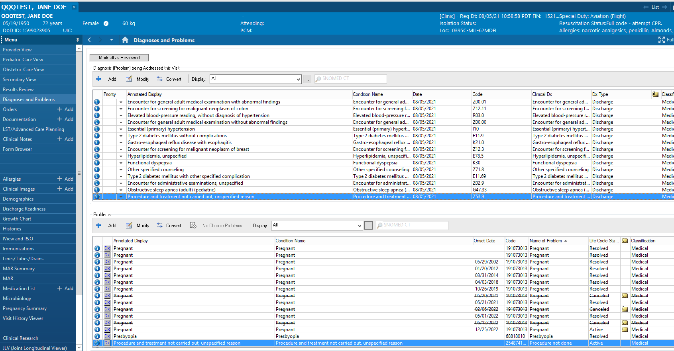

Slide 9
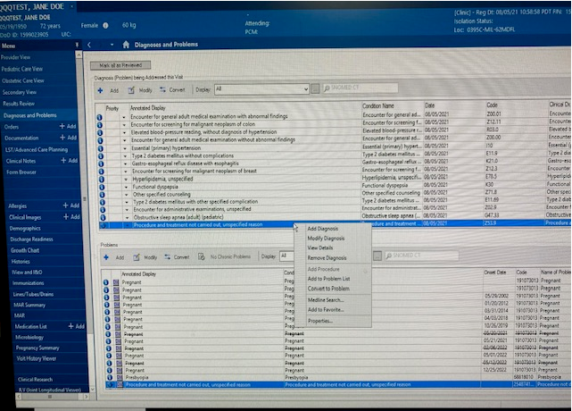

Slide 10
When you do this the first time, you will need to click on “Create Folder” then name a folder.
You can see that the folder I created for Diagnoses is called “Diagnosis” and the one I created for Problems is called “Problems/Dx” to distinguish them (a few slides ahead).

Slide 11
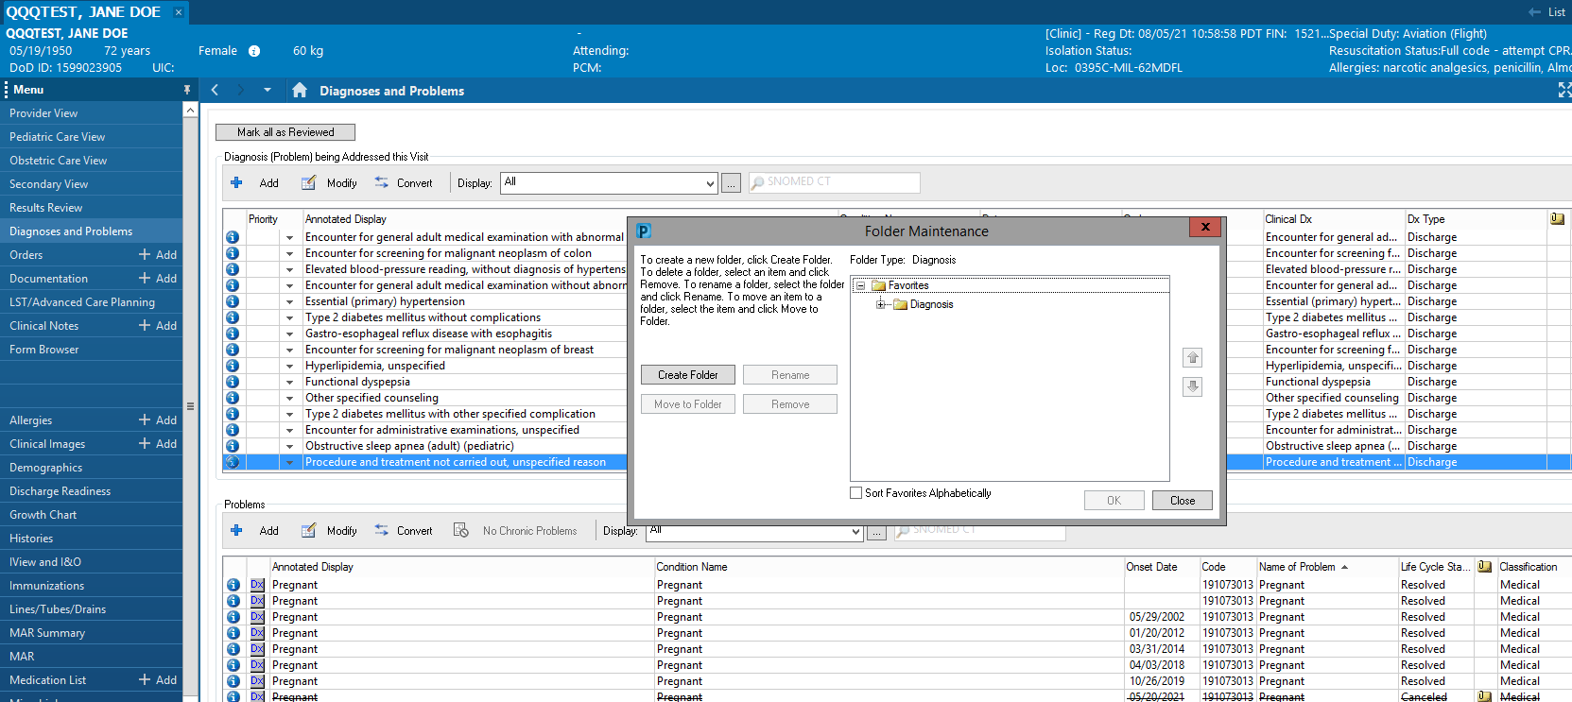

Slide 12
After you have created the folder, click and highlight the folder and then click “Add” to add the diagnosis to the folder.

Slide 13
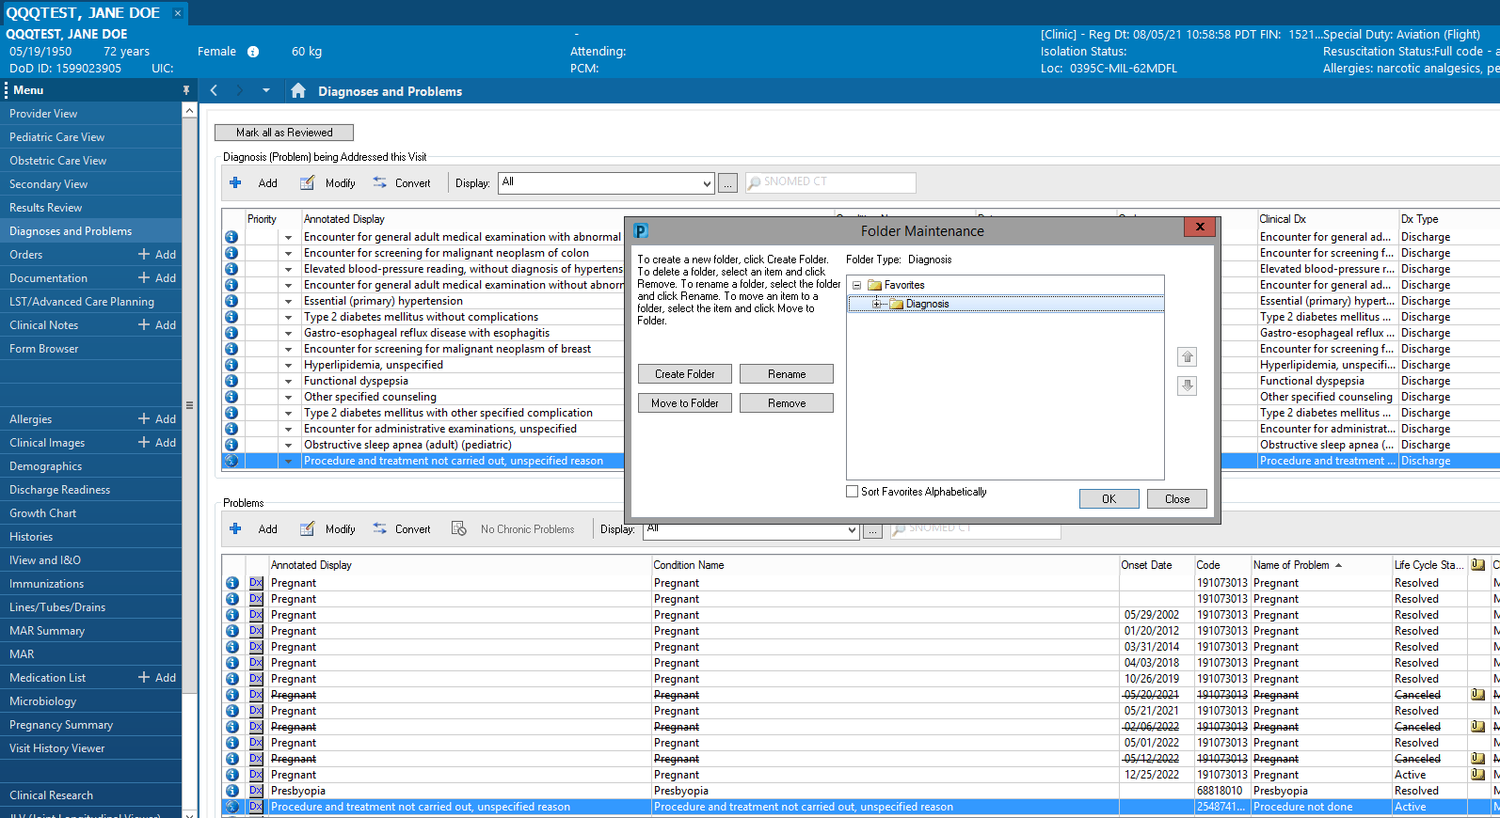

Slide 14
You can then repeat the whole process with the “Problem”
N. B. This entire process works best with a fake patient as you are not worried about creating an incorrect diagnosis or problem. You can always delete them after adding them to a folder but there is another option in a few slides…

Slide 15
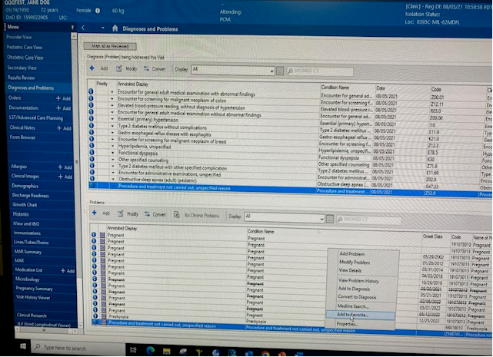

Slide 16
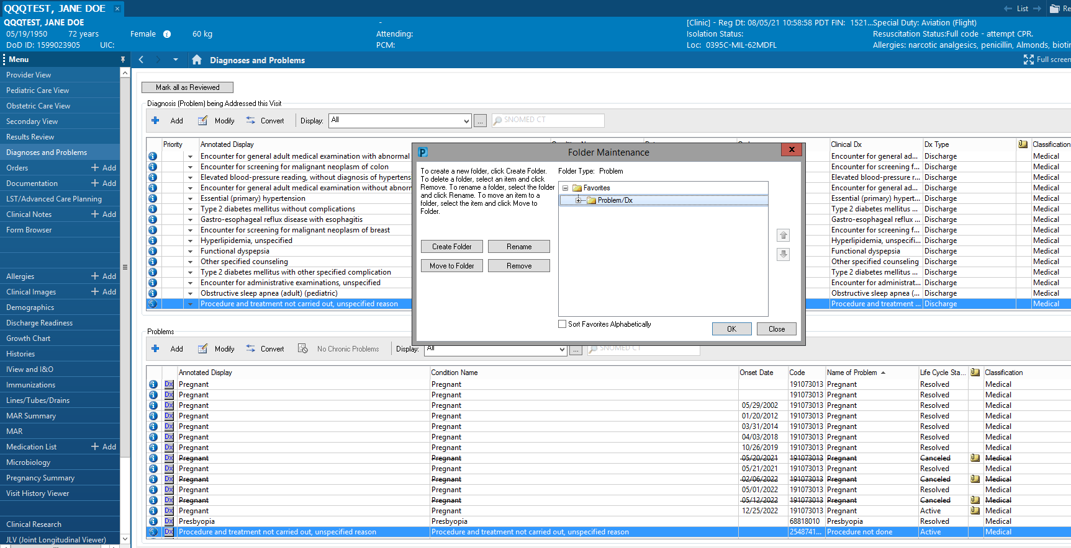

Slide 17
The Other Option…
Enter the diagnosis you are looking for, highlight the specific diagnosis you want, then select “Add to Favorites”.
This will take you through the same process of adding or selecting a folder, then adding the diagnosis/problem to the correct folder.
This allows you to add diagnosis/problem favorites during a real visit without adding the diagnosis/problem to the patient’s chart.

Slide 18
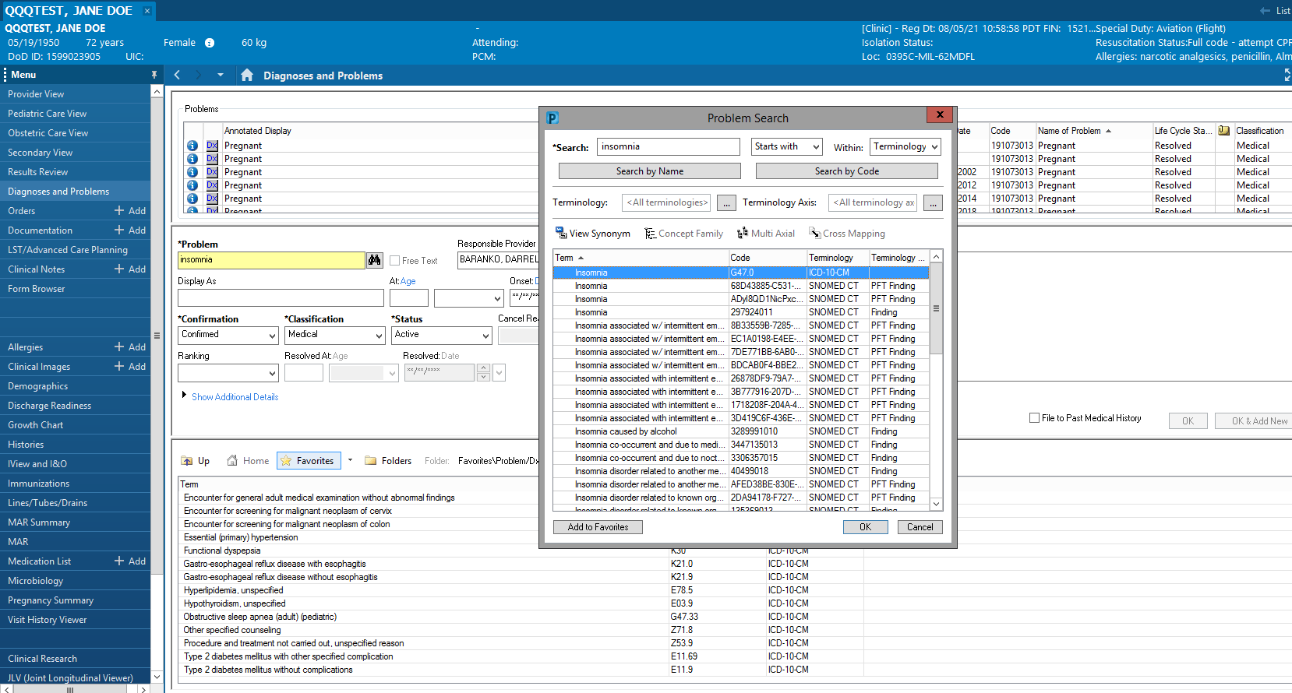

Slide 19
The End Result…
When you go to “Add” the diagnosis from the Diagnoses and Problems screen, you can click on the Gold Star/Favorites, select your favorites folder, and find your diagnosis!

Slide 22
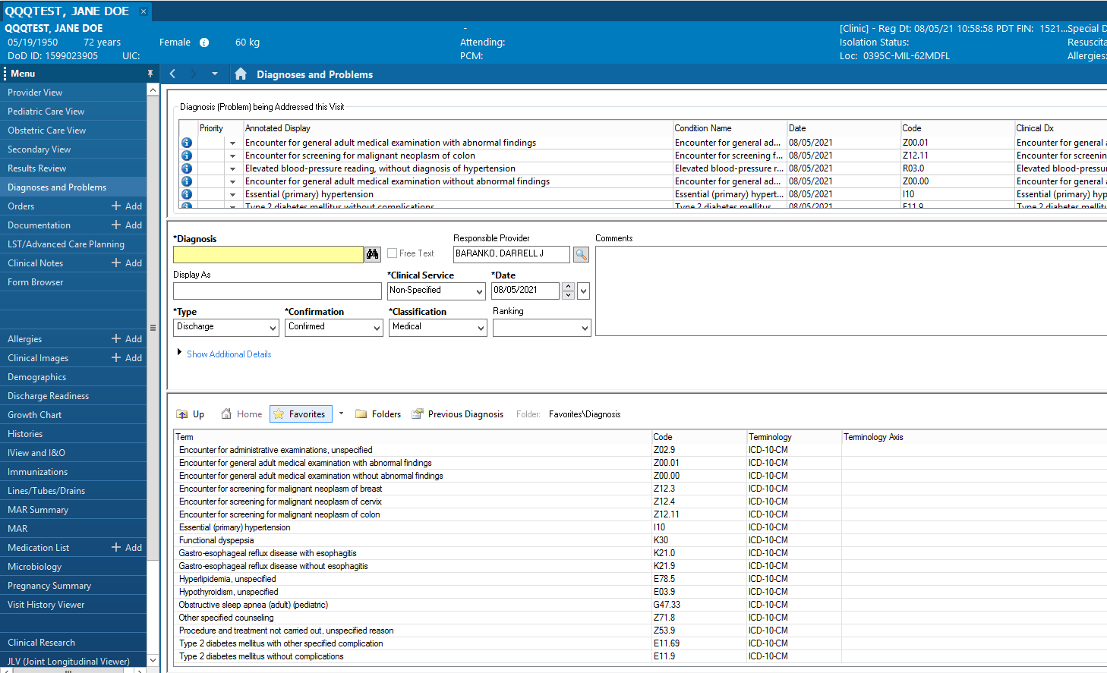

Slide 24
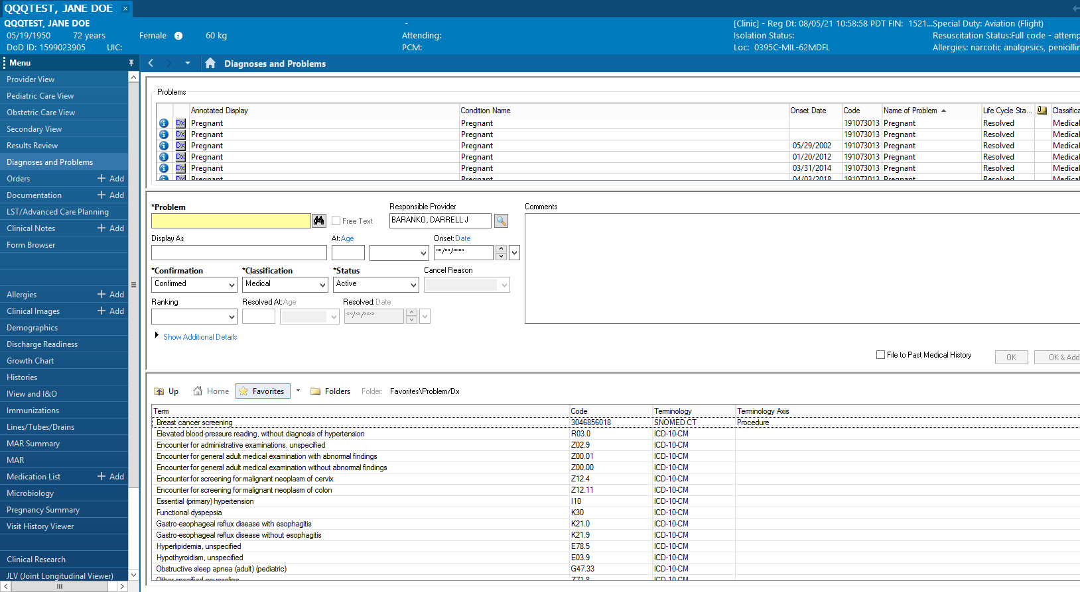

Slide 25
Keep looking for every 1% “marginal gain” you can find with Genesis! They add up!

Slide 26
The End

