Slide 1
OPTIMIZING JLV
Darrell J. Baranko, MD, FACP
December 7, 2022

Slide 2
Disclaimer
All of the JLV training I was able to access provided only information on the what it does and where things appeared on the screen, without any recommendations on how to optimize its utility and efficiency for what we will need to do from now through Genesis.
All recommendations come from my own messing around with JLV.

Slide 3
The Opening Page
Defaults to having a number of widgets which have to load.
Recommendation:
Remove most or all of the widgets and create new TABS

Slide 4
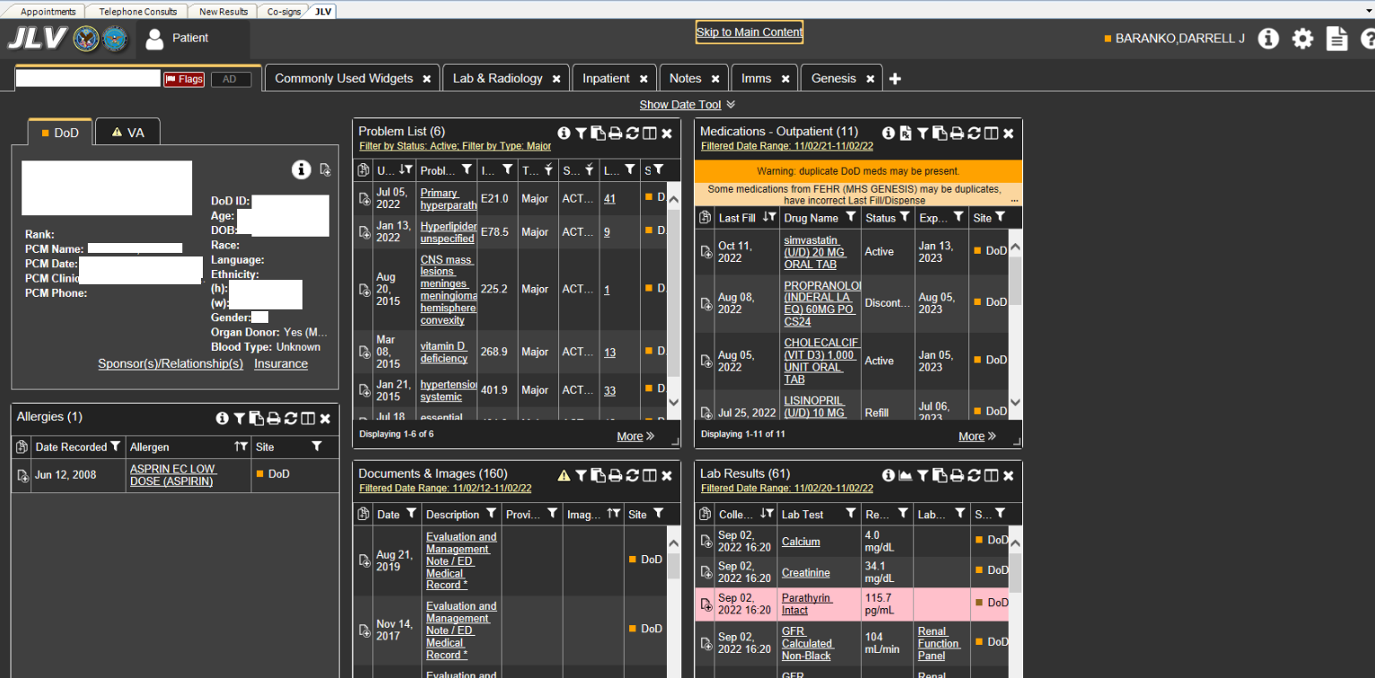

Slide 5
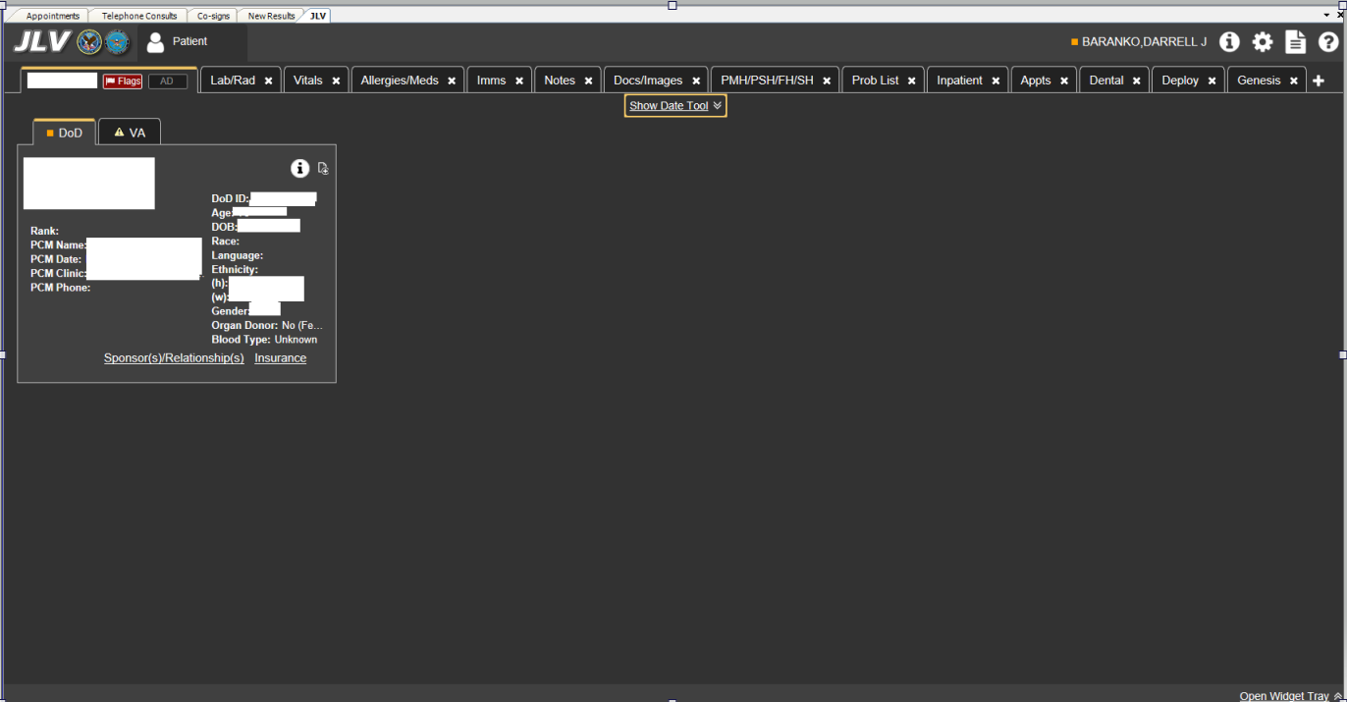

Slide 6
Add Tabs
Tab does not load data until opened so there should not be a difference in speed if you set up more specific tabs.
TIP – Think about the order you want your tabs to appear as you cannot reorder them after they are created.

Slide 8
Widgets
Once you set up a new tab, add your widgets.
The fewer number of widgets in a tab helps to have the specific data load faster.
Just click and drag to add a widget to a tab.

Slide 9
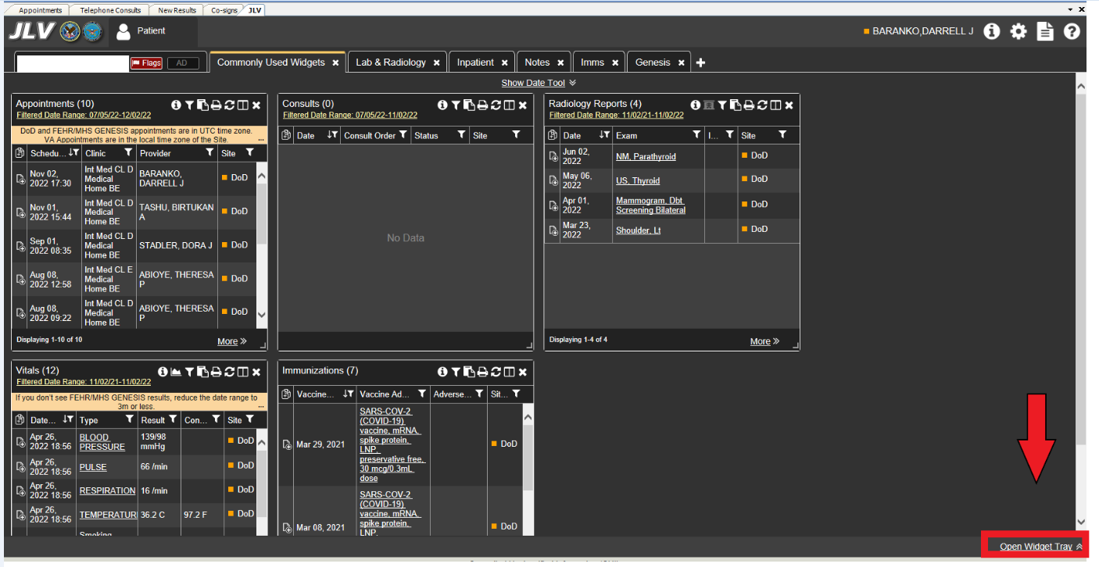

Slide 10
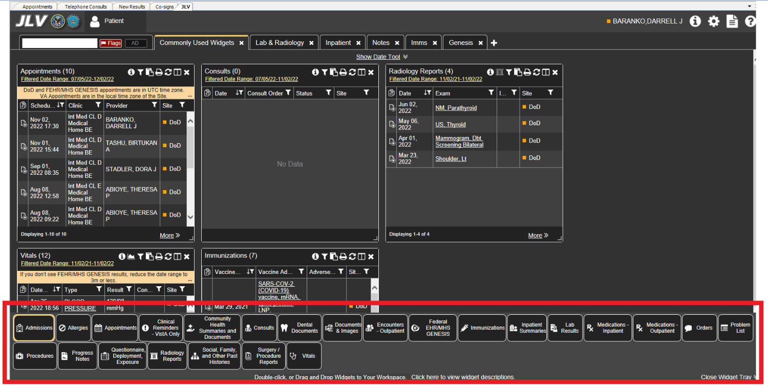

Slide 12
Widgets
Once you have added the widgets you want to your tab MAKE THEM LARGER.
The larger the widget, the faster you can see the data… No more scrolling up and down, side to side.

Slide 13
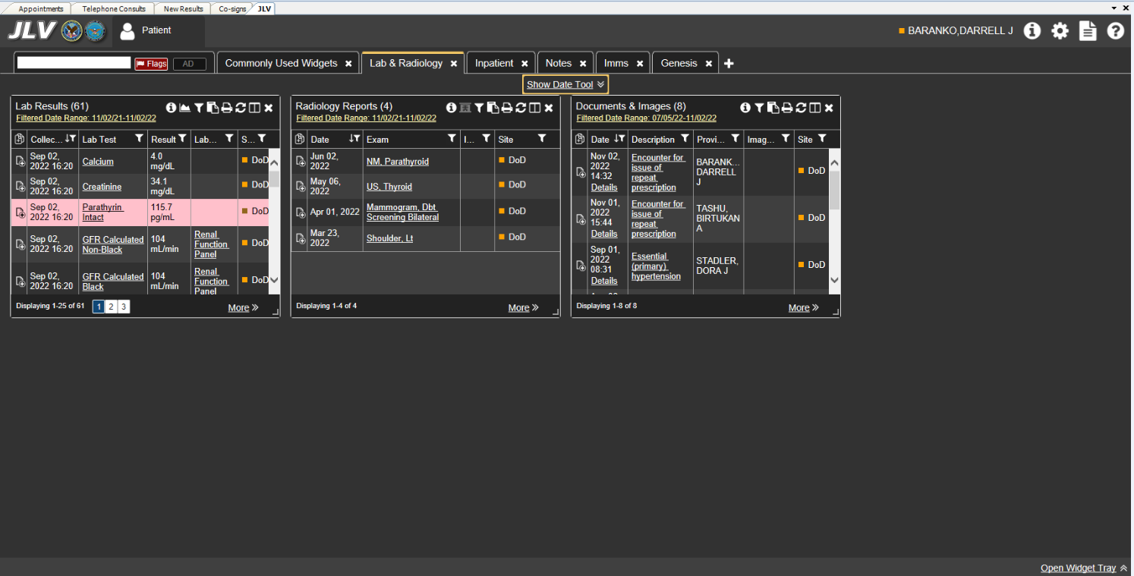

Slide 14
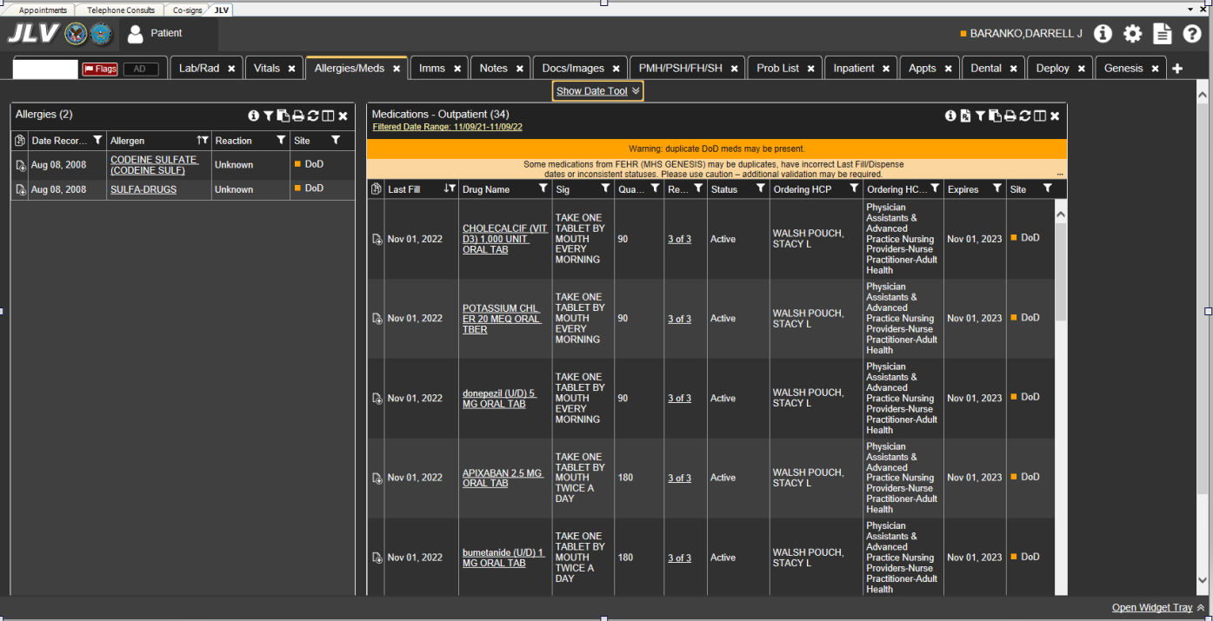

Slide 15
Widgets
Modify the data in the widget to see what you want immediately when it loads.

Slide 16
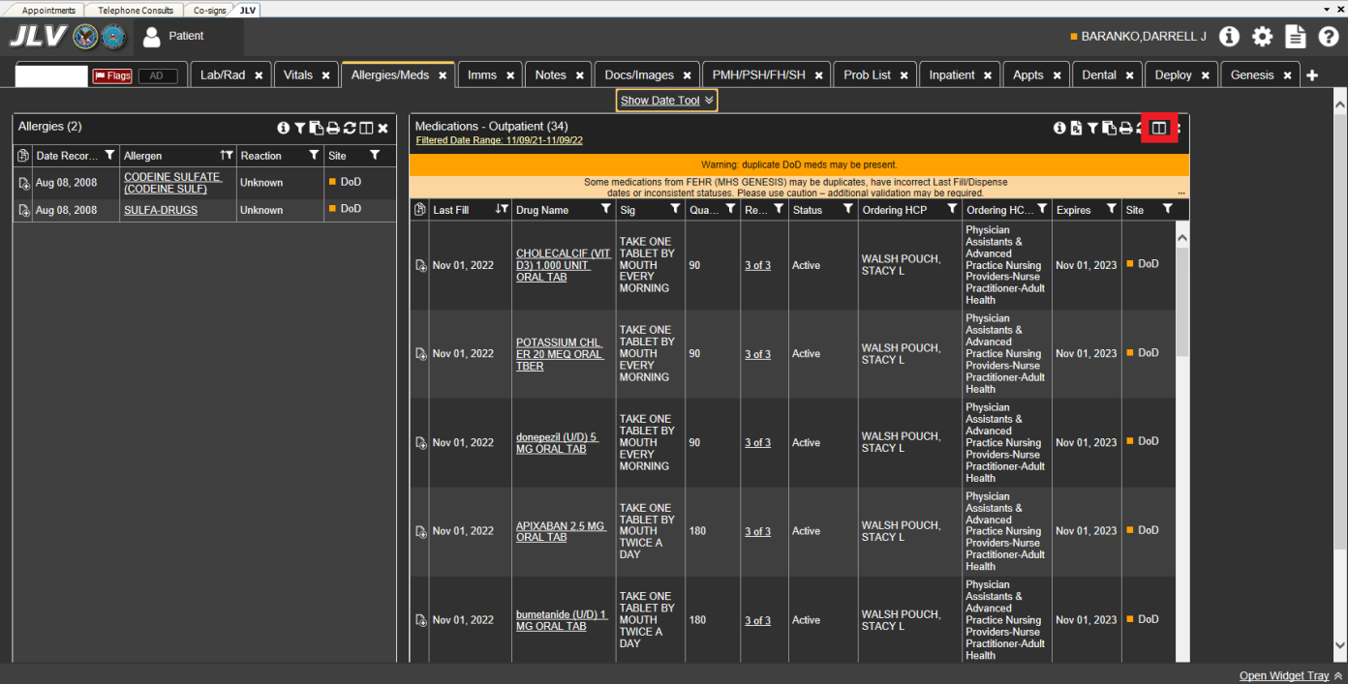

Slide 17
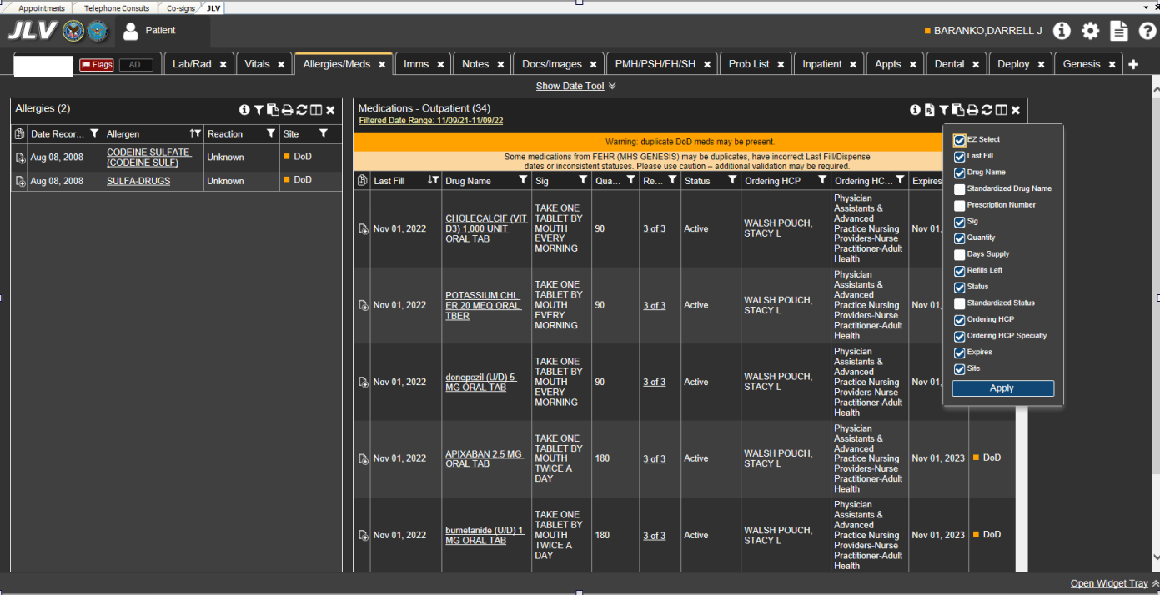

Slide 18
jlv.health.mil
An alternate way to access JLV
Need your CAC for access
My brief trial – not faster than using JLV through AHLTA
But … You can have JLV open on separate screen if using 2 monitors.

Slide 19
Accessing JLV through Genesis

Slide 20
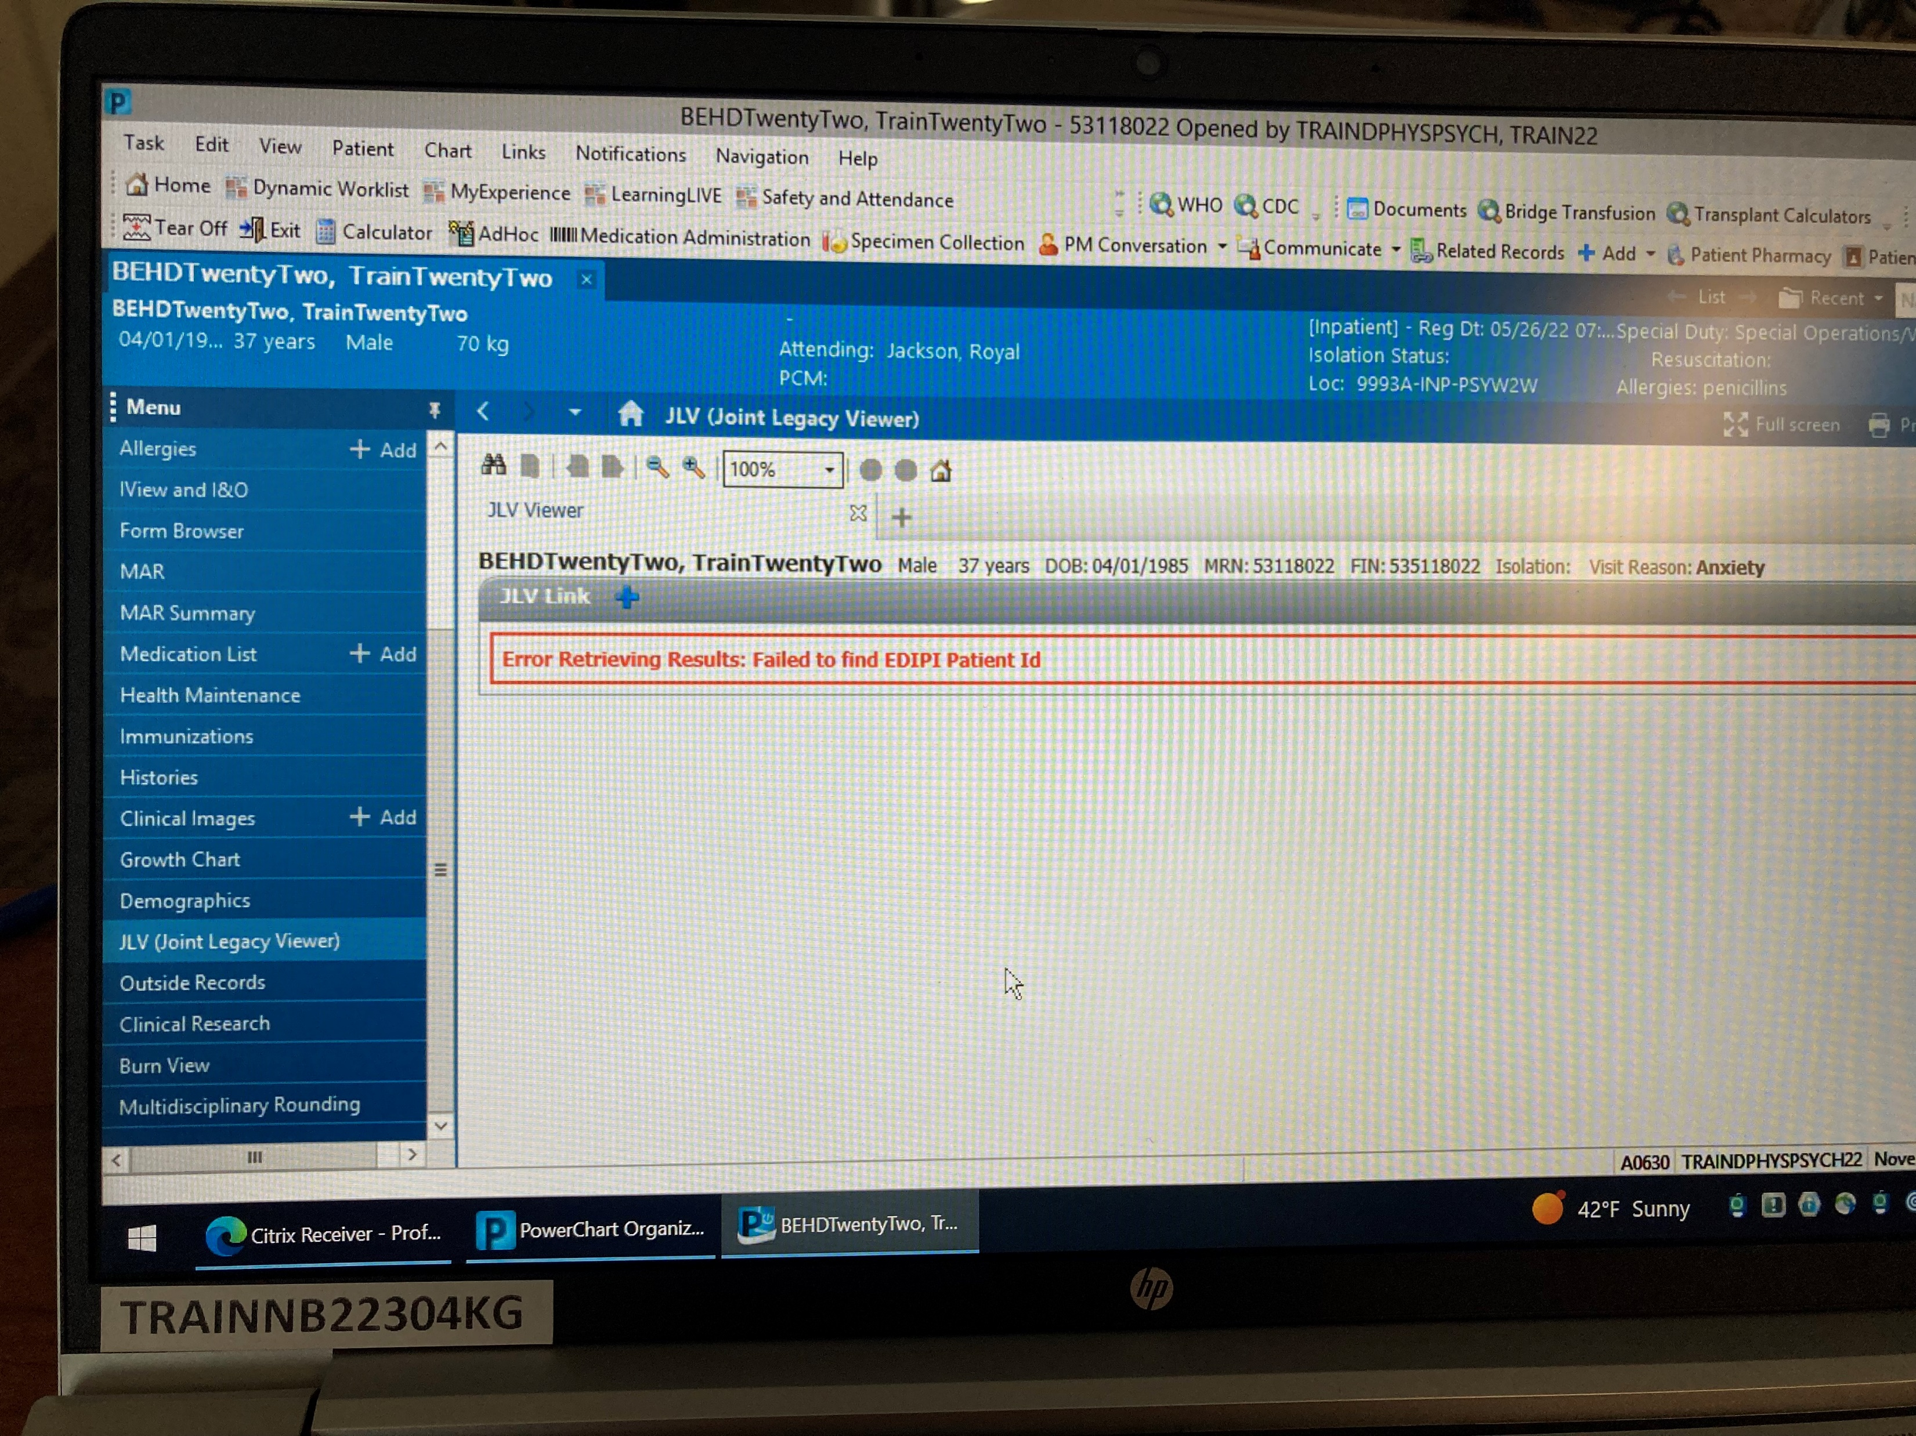

Slide 21
Time to Play with JLV!
Have Fun!

