Slide 1
What’s A Roth?
Medicine, the Military, & Your Money
Meredith L. Olsen, MD
LCDR MC(FS/FMF) USN
Critical Care Medicine Fellow
Notes:
Why I’m here -
Afraid of money
Debt
Investing with my husband
Home buying

Slide 2
Disclaimers
The views expressed are mine alone and do not reflect the official policy or position of the US Navy, Department of Defense or the US Government.

Slide 3
Disclaimers
This talk is geared specifically toward female military physicians and trainees seeking a basic introduction to personal finance.
However, the fundamentals of personal finance apply to all individuals, and everyone is welcome!
Notes:
This is going to be a surface talk - most of these subjects have books, podcasts, blog posts etc written on them individually, and while I want to touch on many subjects, some huge subjects (ie, real estate) will be undoubtedly be left out for the sake of this only being an hour talk and not a 6 week financial course

Slide 4
Disclaimers
Personal finance is deeply personal.
I am not a financial advisor, and this should not be taken as personal financial advice.

Slide 5
Disclaimers
None of the individuals, companies or apps I may mention in this talk pay me any money to do so.

Slide 6
“Give a woman a dollar, and she can put it to good use. Teach her about how money really works, and she can change the world”
- Linda Davis Taylor

Slide 7
My Goals
Provocation
Persuasion
Inspiration
Foundation

Slide 8
https://sayingimages.com/wp-content/uploads/alright-people-lets-do-this-motivational-memes.jpg

Slide 9
American Financial Literacy
Only about 57% of Americans are financially literate
At least 53% of American adults are financially anxious
Two in three families lack a six-week emergency fund
78% of adults live paycheck to paycheck
Three in five adults do not keep a budget
Four in five youths failed a financial literacy quiz
https://www.opploans.com/oppu/articles/statistics-financial-literacy/
Notes:
Standard & Poor’s
2018 FINRA study
Analysis from JP Morgan Chase
2017 Career builder survey
2019 survey
FINRA investor education foundation

Slide 10
American Financial Literacy
27 states scored a C, D, or F for high school financial literacy
54% of millennials are concerned about student loans
60% of adults had credit card debt in the last year
Four in five adults experience barriers to home ownership
Fewer than one in five adults is confident in their savings
https://www.opploans.com/oppu/articles/statistics-financial-literacy/
Notes:
2020 survey of the states
Global financial literacy excellence center
Federal reserve bank
NFCC
NFCC

Slide 11
Mind the Gaps
The Wage Gap:
Women overall make 83 cents to every dollar a man makes
This is worse for women of color:
Black women: 64 cents
Native American women: 60 cents
Latinas: 57 cents
AAPI women: 50-90 cents
https://www.ellevest.com/magazine/disrupt-money/closing-the-gender-pay-gap
Notes:
2020 Census data

Slide 12
Mind the Gaps
The Wealth Gap: Not how much women make compared to men, but how much they own and keep. How much they have.
For every dollar a white man owns, women overall own 32 cents.
Black and Latinx women own as little as 1 cent.
https://www.ellevest.com/magazine/disrupt-money/closing-the-gender-wealth-gap#:~:text=(One%20analysis%20from%202021%20that,a%20man%27s%20median%20household%20wealth.)

Slide 13
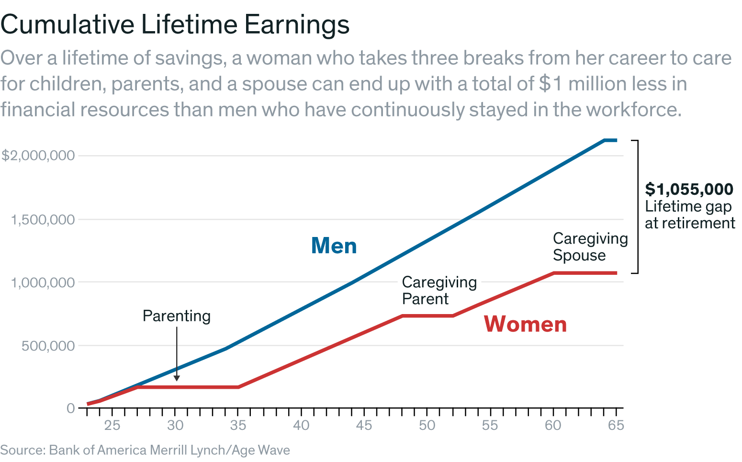
Mind the Gaps
Why?
The wage gap
Workforce time
The investing gap
The debt gap
The pink tax
She-cession
https://www.ellevest.com/magazine/disrupt-money/closing-the-gender-wealth-gap#:~:text=(One%20analysis%20from%202021%20that,a%20man%27s%20median%20household%20wealth.)
https://s.wsj.net/public/resources/images/ON-CM721_201804_NS_20180418134459.png
Notes:
Women spend less time in the workforce, often not by choice. 95% of low-wage workers, most of whom are people of color, don’t get paid leave, which makes it nearly impossible to keep a job if they have children, sick family members, an injury, etc. But even for higher earners, traditional gender roles (or the fact that most women bring in a smaller portion of the household income) mean they’re the ones to stay at home if need be. Less time in the workforce means fewer years earning and building wealth.
The investing gap. Women keep the majority of their money in the bank, while men invest the majority of theirs. That means they’re missing out on the opportunity to earn the kind of returns that investing has historically produced (see: the stock market, which has gone up at an average of 10% a year since 1928). That means they could be missing out on hundreds of thousands — or millions — over a lifetime.
The financial industry is dominated by men. One reason women invest less than men? The industry just wasn’t built for them. (Hence: Ellevest.) A few stats for ya: 86% of financial advisors are men. 98% of mutual fund dollars are managed by men. The wealth management industry ranks worst in terms of sexual harassment. It’s a world that rewards aggressive masculinity — see Reddit memestocks, The Wolf of Wall Street, and how could we forget the Charging Bull?
The debt gap. Women have more student loan debt. They pay half a percent more on credit cards, even controlling for other factors. And they pay higher rates on small business and personal loans, and on mortgages. (They see lower returns in real estate investments, too, losing out on an average of $1,600 per year.)
The pink tax. Women pay more for a ton of things, from razors to clothing (even kids’ clothes) to girls’ toys to senior care. By one estimate, the pink tax costs women $1,350 a year. 😑
Women spend more on their families and spend more of their time performing free labor. Three times as many mothers who work as fathers who work say they make the majority of purchases for the family. And by one New York Times estimate, the unpaid labor performed by American women in 2019 would have been worth an estimated $1.5 trillion (!!) if they’d been paid minimum wage for that work. As sociologist Jessica Calarco puts it, “Other countries have social safety nets. The US has women.”
And, of course, the She-cession. Women (the vast majority women of color) lost 12.2 million jobs in the first three months of the pandemic, and many didn’t (or couldn’t) return. Even now, women are still down 1.8 million jobs from February 2020. (Men are down 1.1 million.) In fact, so many women low-wage workers exited the workforce in 2020 (and thus were no longer counted) that the gender pay gap narrowed.

Slide 14
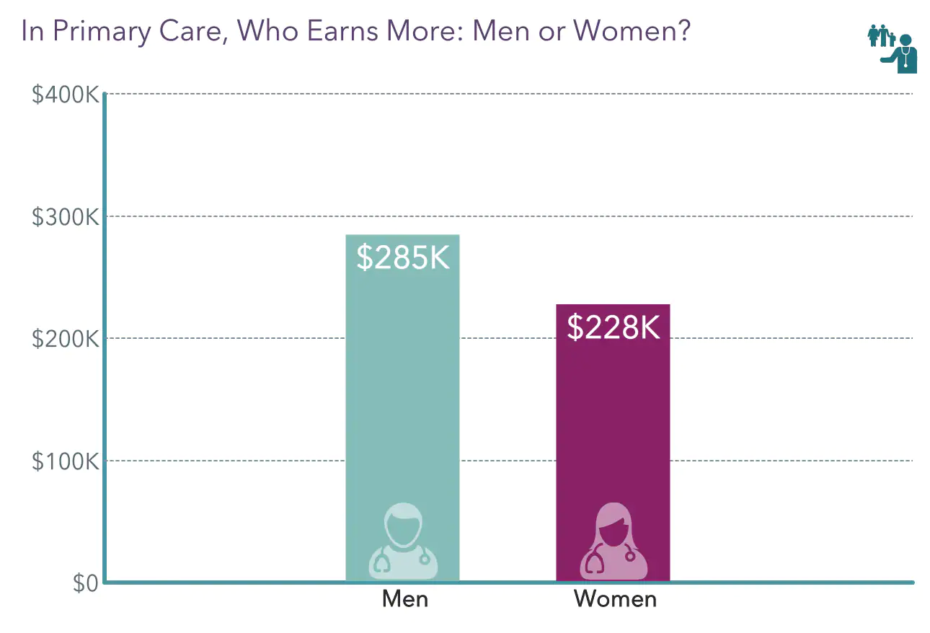
https://img.medscapestatic.com/pi/features/slideshow-slide/2022-compensation-overview-6015043/fig7.png?resize=650:*
Notes:
2022 medscape compensation overview

Slide 15
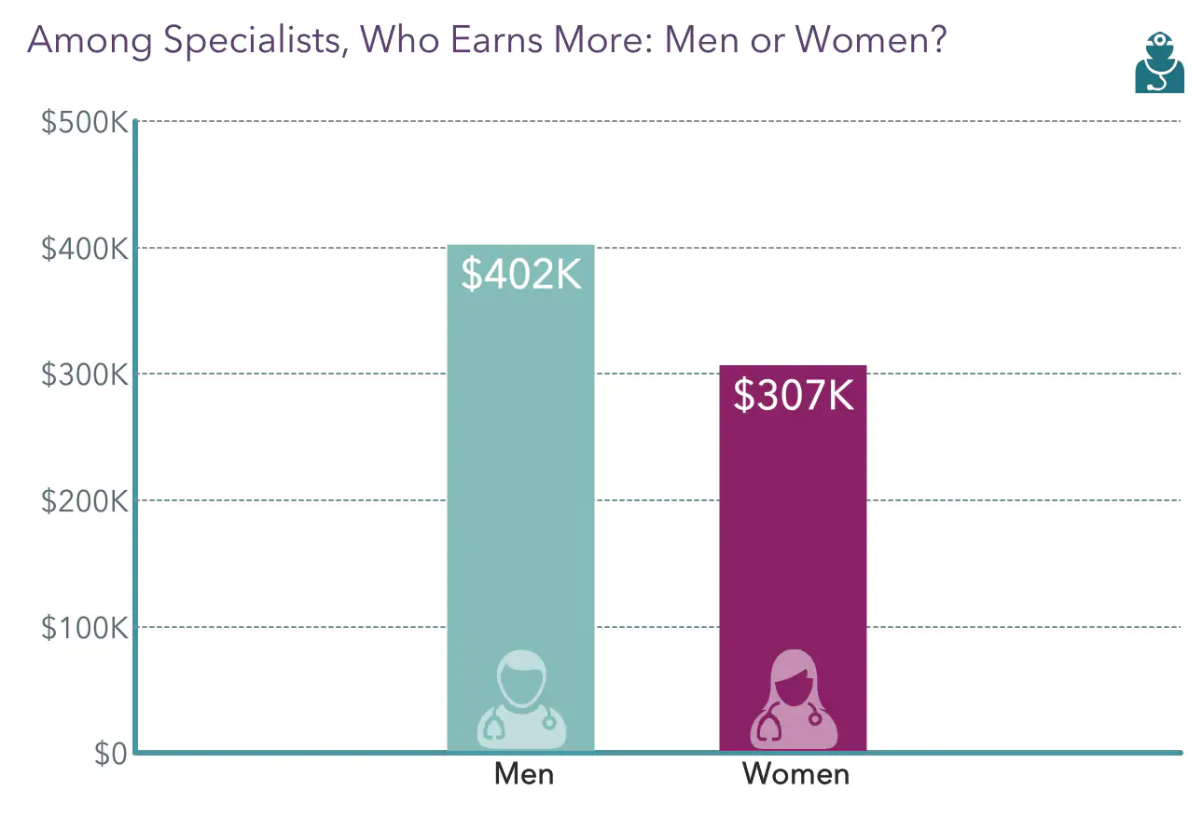
https://img.medscapestatic.com/pi/features/slideshow-slide/2022-compensation-overview-6015043/fig8.png

Slide 16
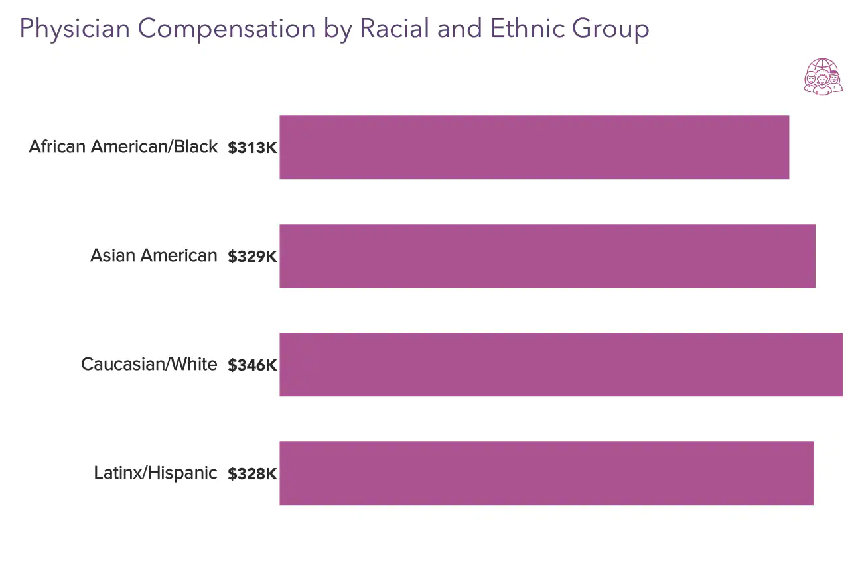
https://img.medscapestatic.com/pi/features/slideshow-slide/2022-compensation-overview-6015043/fig9.png?resize=650:*

Slide 17
The Solution
EDUCATE YOURSELF ABOUT PERSONAL FINANCE
Define Wealth - For YOU
Get financially organized
Notes:
Evidence suggests that comfort with personal finance decreases burnout and increases feelings of personal satisfaction and control at work

Slide 18
The Foundation:
Make Money
Save a Big Chunk of It
Invest it Wisely
Protect it from Loss
Notes:
White Coat Investor

Slide 19
Phase 1:
Make Money

Slide 20
Your Job
Making Your Money
Great news! You are a highly educated, hard working medical professional!
https://nationaltoday.com/wp-content/uploads/2022/07/National-Rosie-the-Riveter-Day.jpg

Slide 21
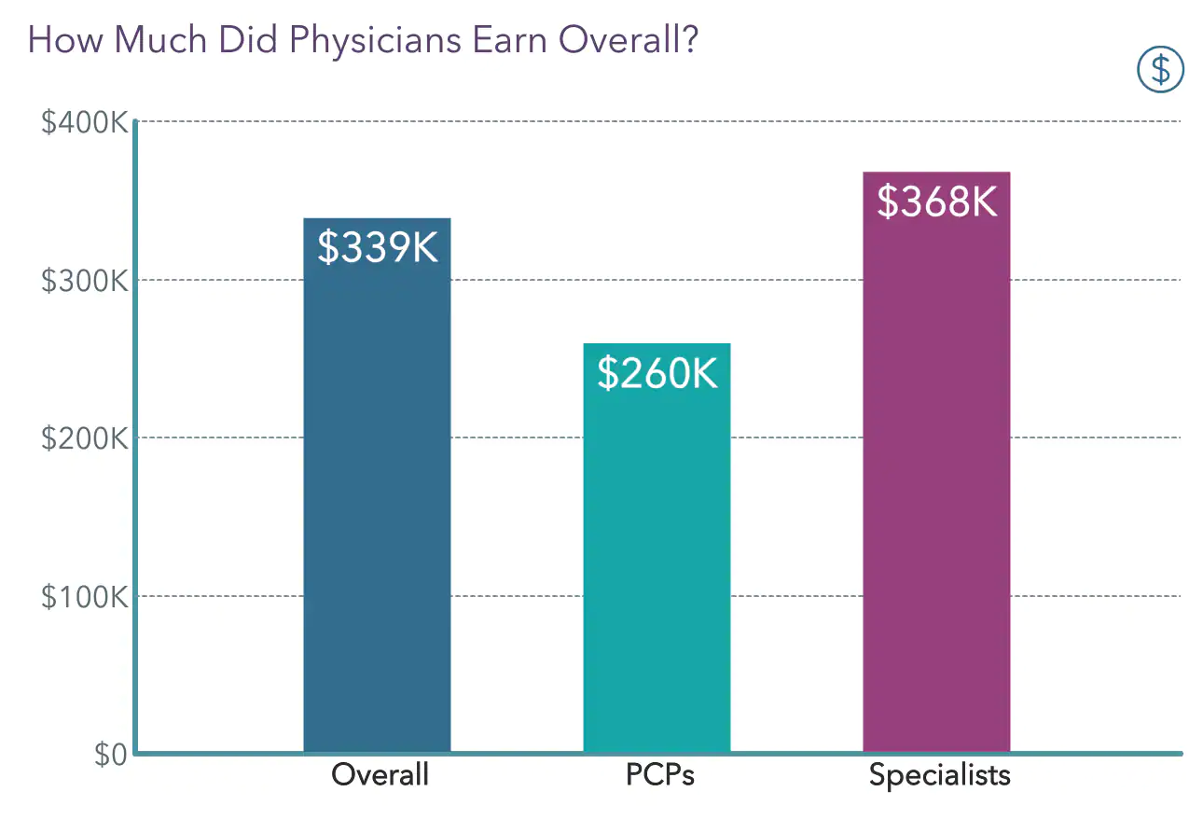
https://img.medscapestatic.com/pi/features/slideshow-slide/2022-compensation-overview-6015043/fig2.png
Notes:
Source: medscape 2022 physician compensation report

Slide 22
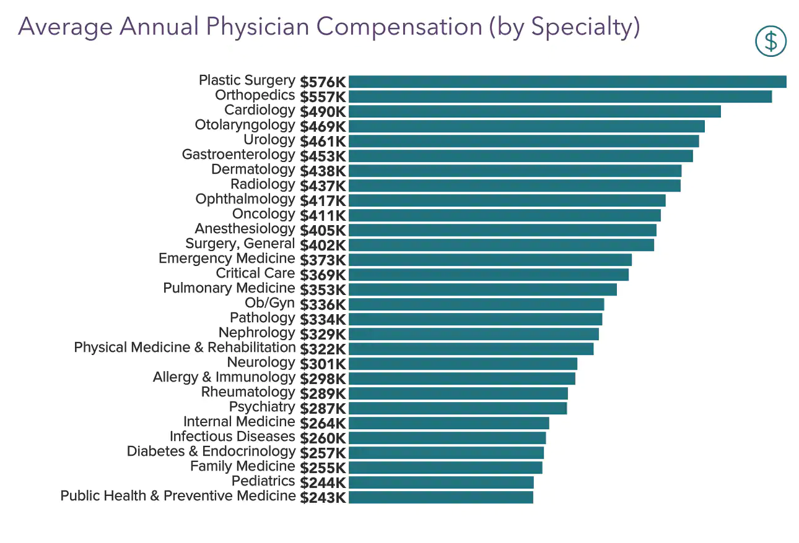
https://img.medscapestatic.com/pi/features/slideshow-slide/2022-compensation-overview-6015043/fig2.png
Notes:
Source: medscape 2022 physician compensation report
You are definitely in the top 10% of US earners, if not in the top 5% ($342,987) as of 2020 Economic Policy Institute data.

Slide 23
Your Job
Making Your Money
According to the Bureau of Labor Statistics (BLS), the median wage for workers in the United States in the second quarter of 2022 was about $1,041 per week or $54,132 per year (assuming 52 weeks of work per year).
Wages were 5.2% higher than a year earlier.
https://www.thebalancemoney.com/average-salary-information-for-us-workers-2060808#:~:text=According%20to%20the%20Bureau%20of,higher%20than%20a%20year%20earlier.
Notes:
The BLS reports that, in the second quarter of 2022, men earned a median annual salary of $59,488, while women made a median annual salary of $49,036, or 82.4% of men’s earnings.⁶
Black men made a median annual salary of $49,556, which is only 82.1% of what White men earned ($55,536). The difference for women was a bit less; Black women’s median annual earnings were 87.9% ($43,680) of White women’s median annual earnings ($49,712).

Slide 24
The Problem for Physicians
Physicians make ~$300K/yr on average (top 5%)
Many have little or no formal education in personal finance or money management
The majority have a net worth of less than $1M
Many live paycheck to paycheck, have not paid off their debt, or have not saved adequately for retirement
Many report financial stress as source of mental health issues, relationship problems, and burnout
Notes:
Societal expectations of the rich doctor, delayed gratification

Slide 25
The Problem for Military Physicians
Physicians in 67% of military medical specialties cannot reach the 20th percentile of what their civilian counterparts make, even at the O-6 level
Family Practice, Internal Medicine, Infectious Disease, Pediatrics and Psychiatry fare better - once at the O-5 and O-6 level
Practice is relatively bureaucratic, inefficient, and subject to deployments/PCS/acts of Congress
https://www.whitecoatinvestor.com/how-much-do-military-doctors-make/

Slide 26
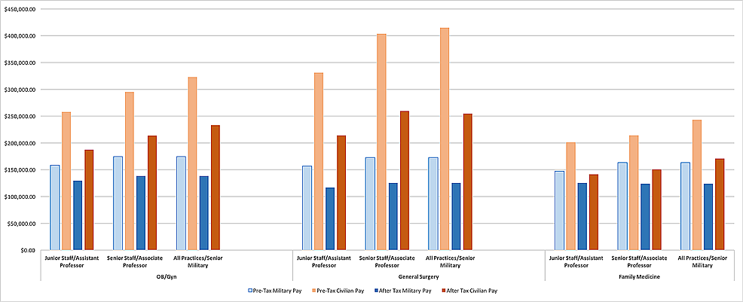
Stortz S K, Foglia L M, Thagard A S, et al. (January 27, 2021) Comparing Compensation of U.S. Military Physicians and Civilian Physicians in Residency Training and Beyond. Cureus 13(1): e12931. doi:10.7759/cureus.12931
Notes:
Stortz S K, Foglia L M, Thagard A S, et al. (January 27, 2021) Comparing Compensation of U.S. Military Physicians and Civilian Physicians in Residency Training and Beyond. Cureus 13(1): e12931. doi:10.7759/cureus.12931

Slide 27
The Balance
Military physicians get paid based on rank, time in service, and the job they’re currently doing
Generally debt-free or reduced debt
Free health insurance
Lots of benefits (taxes, GI Bill, nontaxable income, parental leave, etc)
Reduction of medical malpractice threat
The honor of serving your country
https://www.whitecoatinvestor.com/how-much-do-military-doctors-make/

Slide 28
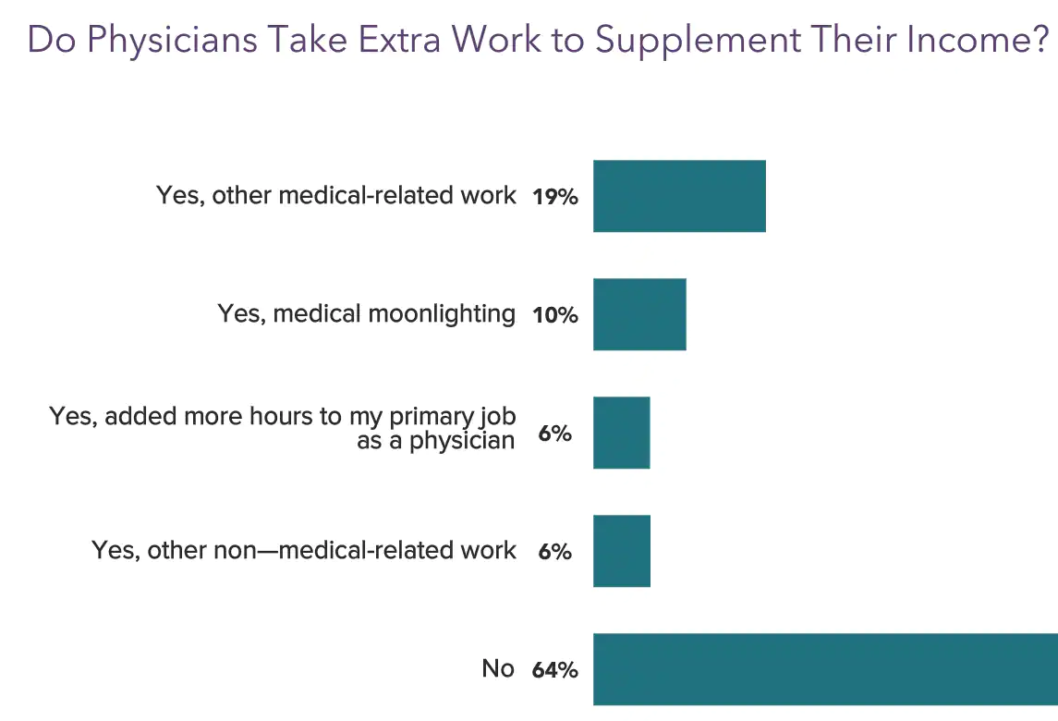
Side Hustles
Moonlighting*
Paid medical surveys
Case review work
Medicolegal work
Elective procedures
Entrepreneurship
Passion projects
https://img.medscapestatic.com/pi/features/slideshow-slide/2022-compensation-overview-6015043/fig11.png
Notes:
36% of physicians take on extra work to supplement their income
Often has to be approved at the command level and may be time-limited

Slide 29
Your Job
Making Your Money
You will not be in the military forever.
Notes:
Know your worth - know how you want to work - learn negotiation strategies.
Pension? BRS vs high-3

Slide 30
Phase 2:
Save a Big Chunk of It

Slide 31
General Rules
The best time to start saving was the day you made your first income.
The next best time is today.
Notes:
The Power of Compound Interest - Time is your friend
Multiple Retirement Calculators

Slide 32
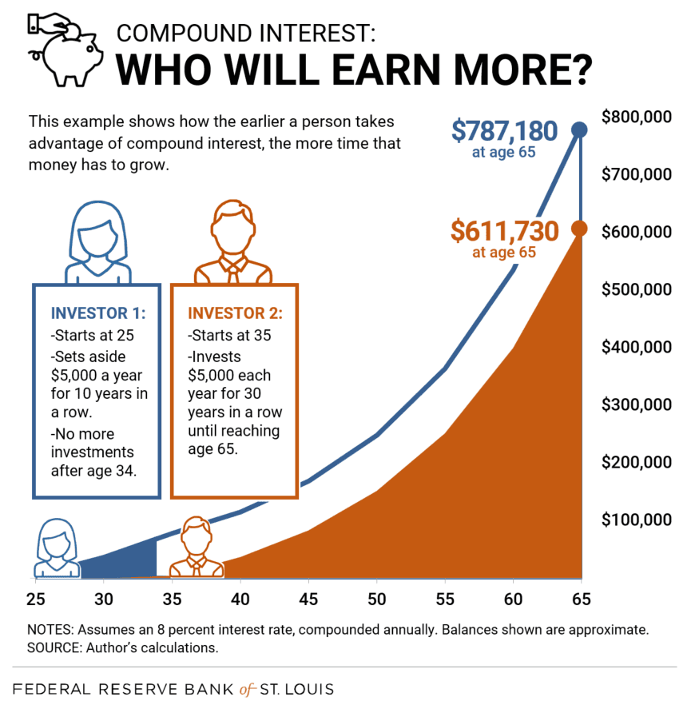
https://www.stlouisfed.org/-/media/project/frbstl/stlouisfed/blog/2018/september/ovblogimage_compoundinterest.png
Notes:
Albert Einstein once said “Compound interest is the eighth wonder of the world. He who understands it, earns it; he who doesn't, pays it”.

Slide 33
How Much Will You NEED?
Dependent upon:
Current age
Pre-tax income
Current savings
Monthly savings
Investment rate of return
Inflation
Additional income (including any pension and social security) in retirement
Goal retirement age
Goal monthly spending in retirement
Life expectancy
Notes:
The Power of Compound Interest - Time is your friend
Multiple Retirement Calculators

Slide 34
How Much Will You NEED?
https://media.makeameme.org/created/well-damn-thats-0b1ca41fae.jpg
Notes:
The Power of Compound Interest - Time is your friend
Multiple Retirement Calculators

Slide 35
How Much Will You NEED?
The 4% Rule
You can spend 4% of your savings in your first year of retirement
Take out that same dollar amount + inflation adjustment every year thereafter
The “Safe Withdrawal Rule”
https://www.nerdwallet.com/article/investing/how-long-will-your-retirement-savings-last
Notes:
The 4% rule is based on research by William Bengen, published in 1994, that found that if you invested at least 50% of your money in stocks and the rest in bonds, you’d have a strong likelihood of being able to withdraw an inflation-adjusted 4% of your nest egg every year for 30 years (and possibly longer, depending on your investment return over that time). Validated by the Trinity study published in 1998.
Bengen tested his theory across some of the worst financial markets in U.S. history, including the Great Depression, and 4% was the safe withdrawal rate.
The 4% rule is relatively rigid. The amount you withdraw each year is adjusted by inflation and nothing else, so finance experts have come up with a few methods to increase your odds of success, especially if you’re looking for your money to last a lot longer than 30 years.
These methods are called “dynamic withdrawal strategies.” Generally, all that means is you adjust in response to investment returns, reducing withdrawals in years when investment returns aren’t as high as expected, and — oh, happy day — pulling more money out when market returns allow it.

Slide 36
How Much Will You NEED?
The 25x Rule
In order to stick with the 4% withdrawal rate, most people would need to have 25x their annual expenses in their portfolio
Inflation, Social Security, Early Retirement, Rate of Return
Some people prefer The 33x Rule.
https://investorjunkie.com/retirement/25x-rule/

Slide 37
Retirement Calculators
Vanguard Retirement Calculator
Nerdwallet Retirement Calculator
Personal Capital Retirement Planner

Slide 38
Numerical Soup
Notes:
The 5% Rule
Over 50? Catch up contributions - additional $6,500.

Slide 39
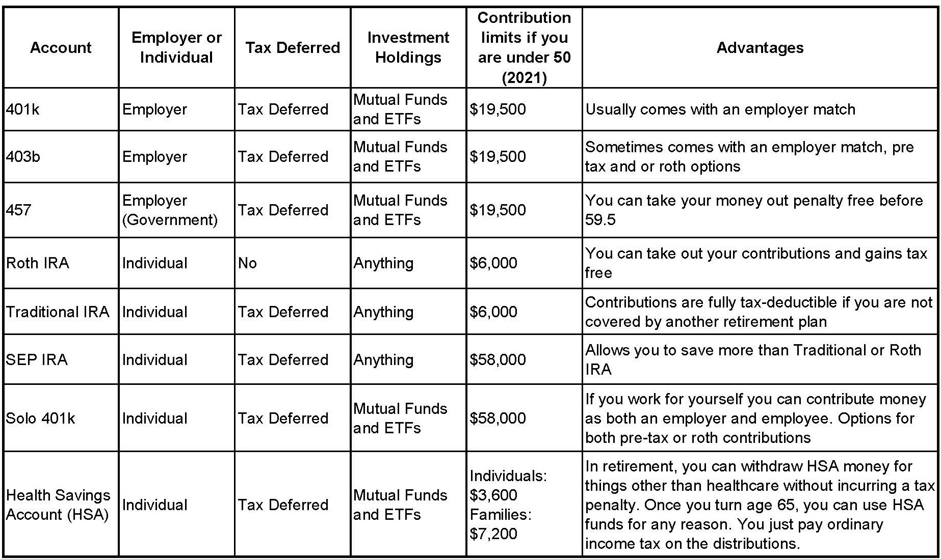
https://www.google.com/url?sa=i&url=https%3A%2F%2Fbaylaart.com%2FRetirement-for-Artists&psig=AOvVaw2pCG2-qe_yWflBAofMWMjR&ust=1664441064023000&source=images&cd=vfe&ved=0CAwQjRxqFwoTCPD38KWMt_oCFQAAAAAdAAAAABAD
Notes:
Special shout out to 529s and UTMAs - great for funding college savings and saving money for kids… but this is in addition to your minimum 20% retirement savings goals

Slide 40
Retirement Planning
You Don’t Have To Work Forever
Maximize your Roth IRA contributions
IRS Limit: $6,000/yr (>50: $7,000/yr)
Learn the rules regarding income limits and tax filing status as they apply to you
Backdoor Roths are still possible!
https://hr.nih.gov/benefits/retirement/2022-thrift-savings-plan-tsp-contribution-limits-and-tsp-spillover-method#:~:text=The%202022%20IRS%20annual%20limit,end%20of%20the%20calendar%20year.
Notes:
Waterfall approach

Slide 41
Retirement Planning
You Don’t Have To Work Forever
Maximize your TSP contributions
IRS limit for regular contributions in 2022: $22,500/yr
ALWAYS get the match (5% for DOD)
Over 50? Catch up!
https://hr.nih.gov/benefits/retirement/2022-thrift-savings-plan-tsp-contribution-limits-and-tsp-spillover-method#:~:text=The%202022%20IRS%20annual%20limit,end%20of%20the%20calendar%20year.
Notes:
Over 50? Catch up contributions - additional $6,500.

Slide 42
Retirement Planning
You Don’t Have To Work Forever
Contribute to other tax-advantaged and tax-protected accounts as your goals dictate (TSP, 401K, 403B, HSA*, etc)
THEN contribute to a taxable account to meet your total retirement savings goal
https://hr.nih.gov/benefits/retirement/2022-thrift-savings-plan-tsp-contribution-limits-and-tsp-spillover-method#:~:text=The%202022%20IRS%20annual%20limit,end%20of%20the%20calendar%20year.
Notes:
Work up to these goals - 20% of your gross income may not completely fill these accounts until you are out of training.

Slide 43
BRS vs. High-3

Slide 44
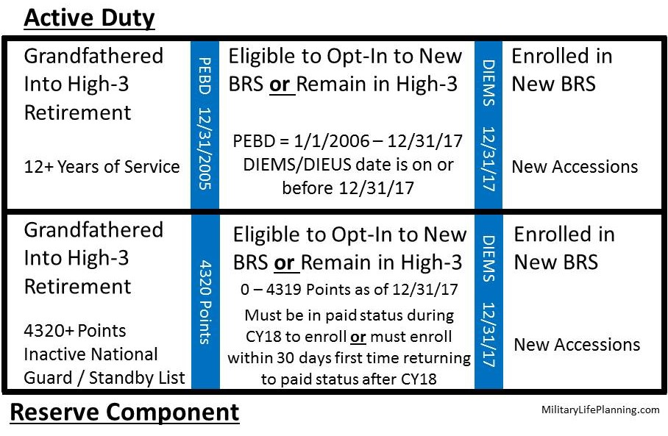
BRS vs HIGH 3

Slide 45
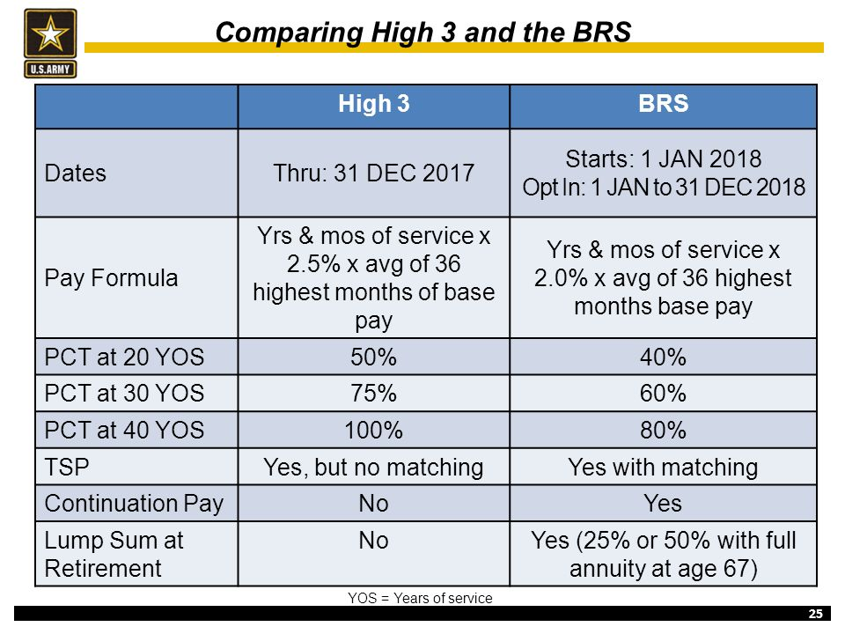
https://slideplayer.com/slide/10660770/36/images/25/Comparing+High+3+and+the+BRS.jpg
Notes:
The BRS provides a defined benefit, which is a monthly pension payment for life, after 20 years or more of active-duty service.
The difference is in how much you contribute to the TSP

Slide 46
https://slideplayer.com/slide/15726165/88/images/19/Differences+between+the+High-3+and+the+BRS.jpg

Slide 47
BRS vs HIGH 3
https://militarypay.defense.gov/Calculators/BRS/

Slide 48
Debt
Paying What You Owe
Develop a Plan
Consolidate
Refinance
Loan forgiveness
Notes:
A huge issue for many Americans, and many American physicians

Slide 49
Pay Off Debt or Save for Retirement?
The White Coat Investor Approach:
Get employer match!
Pay off high interest rate debt (8% or more)
Max out available retirement accounts
Invest in assets with high expected returns (15-20%?!)
Pay off moderate interest rate debt (4-7%)
Invest in assets with moderate expected returns
Pay off low interest rate debt (1-3%)
Invest in assets with low expected returns (or buy something)
https://www.whitecoatinvestor.com/invest-or-pay-off-debt/
Notes:
Probably the best advice I can give you with regards to the payoff debt vs. invest question is to avoid the extremes. With this question, 95% of the time there is no right answer, but 5% of the time there is. So, don't botch it that 5% of the time. For example, if you're giving up an employer match in order to pay off debt, you're making a mistake. You're leaving part of your salary on the table. Likewise, if you're carrying around 30% credit card debt and hope that your investments are going to outperform it, you're making a mistake.
But for just about everything else in between, I can come up with a situation where it makes sense to invest, but I could also come up with a situation where it makes sense to pay off the debt. No matter what kind of debt that might be. These are both good things. It's good to pay off debt. It builds your net worth. It is good to invest. That also builds your net worth. So, it’s not like one of them is wrong and one of them is right. They're both right. If you can't tell which one is better for you, it probably doesn't matter much

Slide 50
AUTOMATE
Automate Everything You Can
Retirement Savings
Debt Payments
Bill Payments

Slide 51
Budgeting
Using Your Money
Now, you finally have money left over from saving for retirement and paying down debt!
https://sayingimages.com/wp-content/uploads/excited-sheep-woohoo-meme.jpg
Notes:
Can we just spend willy nilly? Uh, no. Of course not. Hated budgeting forever, now find it very freeing.
For those who know me, husband spent yr in Boston and now in Norfolk, 3 year old son, epileptic dog, fellowship, rotating cast of family members

Slide 52
Budgeting
Using Your Money
You Will Need:
Your “Take Home” Pay
Monthly Expenses
Recurring Non-Monthly Expenses
Savings Goals
“Just for Fun” Expenses

Slide 53
Budgeting
Using Your Money
Traditional Options:
Paper, Excel, Envelope system
https://i.kym-cdn.com/entries/icons/original/000/001/180/5018904-clippy-black-tar-heroin-memes-png-image-transparent-png-free-clippy-transparent-820_502.png

Slide 54
Budgeting
Using Your Money
Apps & Online Options:
Personal Capital, Mint, YNAB,
EveryDollar, Honeydue
Notes:
And more!
Personally -
Excel for tracking my LES and estimating our taxes for withholding purposes (estimate your tax bracket)
Personal Capital for tracking expenses, joint accounts, and net worth with husband
YNAB for personal budgeting (can use Honeydue) - zero based budgeting is a game changer for me, gives every dollar a job, and some of those jobs are to entertain and do fun things for me and for our family!

Slide 55
A Word about Lifestyle
Notes:
Lifestyle inflation is real and understandable
Live within your means - build savings, build retirement accounts, be financially responsible - can also enjoy your life.

Slide 56
Phase 3:
Invest It Wisely
Notes:
Women are better investors https://www.cnbc.com/2022/04/11/op-ed-heres-why-women-are-better-investors-than-men.html
Outperform men by 40 basis points or 0.4% on average - take less risk, less impulsive, more research. Fidelity 2021 Women and Investing
chrome-extension://efaidnbmnnnibpcajpcglclefindmkaj/https://www.fidelity.com/bin-public/060_www_fidelity_com/documents/about-fidelity/FidelityInvestmentsWomen&InvestingStudy2021.pdf?ccmedia=Facebook&ccchannel=social_organic&cccampaign=womens&ccdate=202112&cccreative=bau_womensstudy&ccformat=image&sf251615226=1

Slide 57
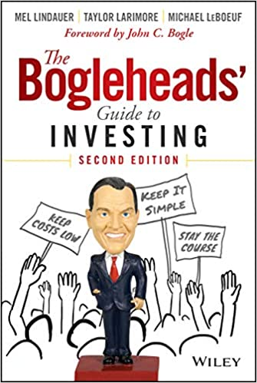
The Boglehead Principles
Develop a workable plan
Invest early & often
Never bear too much or too little risk
Diversify
Never try to time the market
Use index funds when possible
Keep costs low
Minimize taxes
Invest with simplicity
Stay the course
https://m.media-amazon.com/images/I/51TELEHIRbL.jpg
Notes:
WCI - They've learned the importance of buy and hold, the importance of keeping costs low, and the importance of using passive investments over active ones.
Vanguard and Fidelity - low cost index funds

Slide 58
Asset Allocation
200 Portfolios Better Than Yours
Notes:
WCI - The truth is that no one knows which portfolio is going to outperform in the future. You can change all the factors you want — more or less diversification, additional risks/factors, lower costs vs additional risk or diversification, more of this and less of that. Does it matter? Absolutely. Take a look at Madsinger's Monthly Report some time, where a Bogleheads poster has been tracking the returns of a dozen balanced portfolios for the last decade. But it doesn't matter that much. No diversified portfolio in that report has done better than 1-2% per year more than a similarly risky portfolio over the last 15 years. Now 1-2% does matter, especially over long periods of time, but keep in mind the edge that a very complex portfolio might provide over a very simple one can easily be eaten up by advisory fees, behavioral errors, and poor tax management.

Slide 59
Asset Allocation
Set your goals
Develop your asset allocation
Implement your asset allocation
Maintain your asset allocation

Slide 60
Financial Advisors
Understand how they are getting paid
Avoid commission based
Understand what they are costing you
Fiduciary
CFP, CFA, ChFC, CPA
Understand the services they can provide you
Financial plan
Insurance
Taxes
Notes:
A fiduciary is a person or organization that acts on behalf of another person or persons, putting their clients' interests ahead of their own, with a duty to preserve good faith and trust. Being a fiduciary thus requires being bound both legally and ethically to act in the other's best interests- Investopedia
https://www.whitecoatinvestor.com/how-i-would-choose-a-financial-adviser/
https://www.whitecoatinvestor.com/12-things-you-should-know-about-choosing-a-financial-adviser/

Slide 61
Phase 4:
Protect It From Loss

Slide 62
Insurance
Protecting Your Money
Disability Insurance
Would VA compensation be enough for you?
Liability Insurance
Malpractice
Feres Doctrine
Federal Torts Reform Act
Personal (auto, homeowner, renter’s)
Umbrella
Term Life Insurance
Health Insurance
https://www.whitecoatinvestor.com/life-insurance/
Notes:
Disability - insurance companies will allow you to buy enough insurance to replace 60 percent of your gross income, up to about $20,000 a month
Servicemembers' Group Life Insurance (SGLI) is low-cost term insurance for members of the uniformed services. SGLI is a group life insurance policy purchased by the Department of Veterans Affairs (VA) from a commercial life insurance company. SGLI coverage is available in $50,000 increments up to the maximum amount of $400,000. Servicemembers are automatically insured for the maximum coverage amount of $400,000 unless they decline coverage or elect a reduced amount. SGLI members have two options available to them upon release from service. They can convert their full-time SGLI coverage to renewable term insurance under the Veterans' Group Life Insurance (VGLI) program or to a permanent plan of insurance with one of the participating commercial insurance companies.
Term life insurance is a fantastic option if you’re the primary breadwinner in your household. Even stay-at-home parents may buy it, given how expensive their service to the family would be to replace. You should consider it if you’re a younger doc at the beginning of your career so you can protect your beneficiaries when you haven’t saved much yet in terms of retirement assets. Term life insurance is also typically more affordable when you are younger and likely healthier.
A physician's goal should be to get term life insurance for a certain period of time. Once that time frame expires, they hopefully would be financially independent. Therefore, that doc wouldn't need life insurance anymore anyway.

Slide 63
Estate Planning
You Can’t Take It With You
Assets go where you want them after you die
Your desires are carried out
Minimize required estate taxes paid to the government
Avoiding probate
https://www.whitecoatinvestor.com/introduction-to-estate-planning/

Slide 64
Financial Independence
FIRE/FIRO
https://memegenerator.net/img/instances/400x/47843874.jpg
Notes:
Concept of enough money (whatever that means to you) to feel free to make decisions about your work

Slide 65
Recommended Resources
I Will Teach You To Be Rich - Ramit Sethi
White Coat Investor - Dr. Jim Dahle
Financial Residency - Ryan Inman
https://mccareer.org/ - CAPT Joel Schofer, MD, USN
Physician on FIRE - Dr. Leif Dahleen, MD
The GAO Report

Slide 66
Thank You!
Questions?

